Slide 1

From Prototype to Enterprise:
Multi-Agent AI Governance and Scaling in Azure

Slide 2
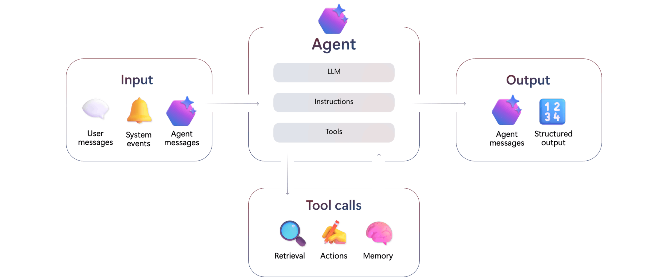
What is an AI Agent?

Slide 3
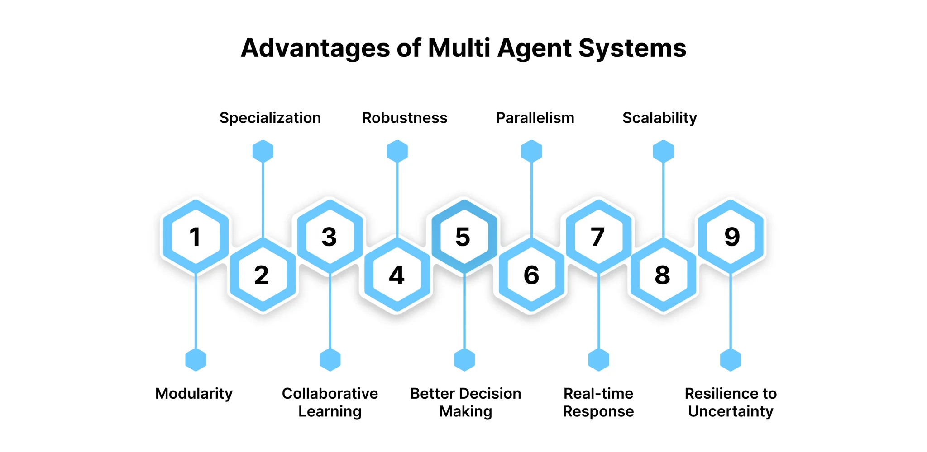
What is the need for a Multi AI Agent?

Slide 4
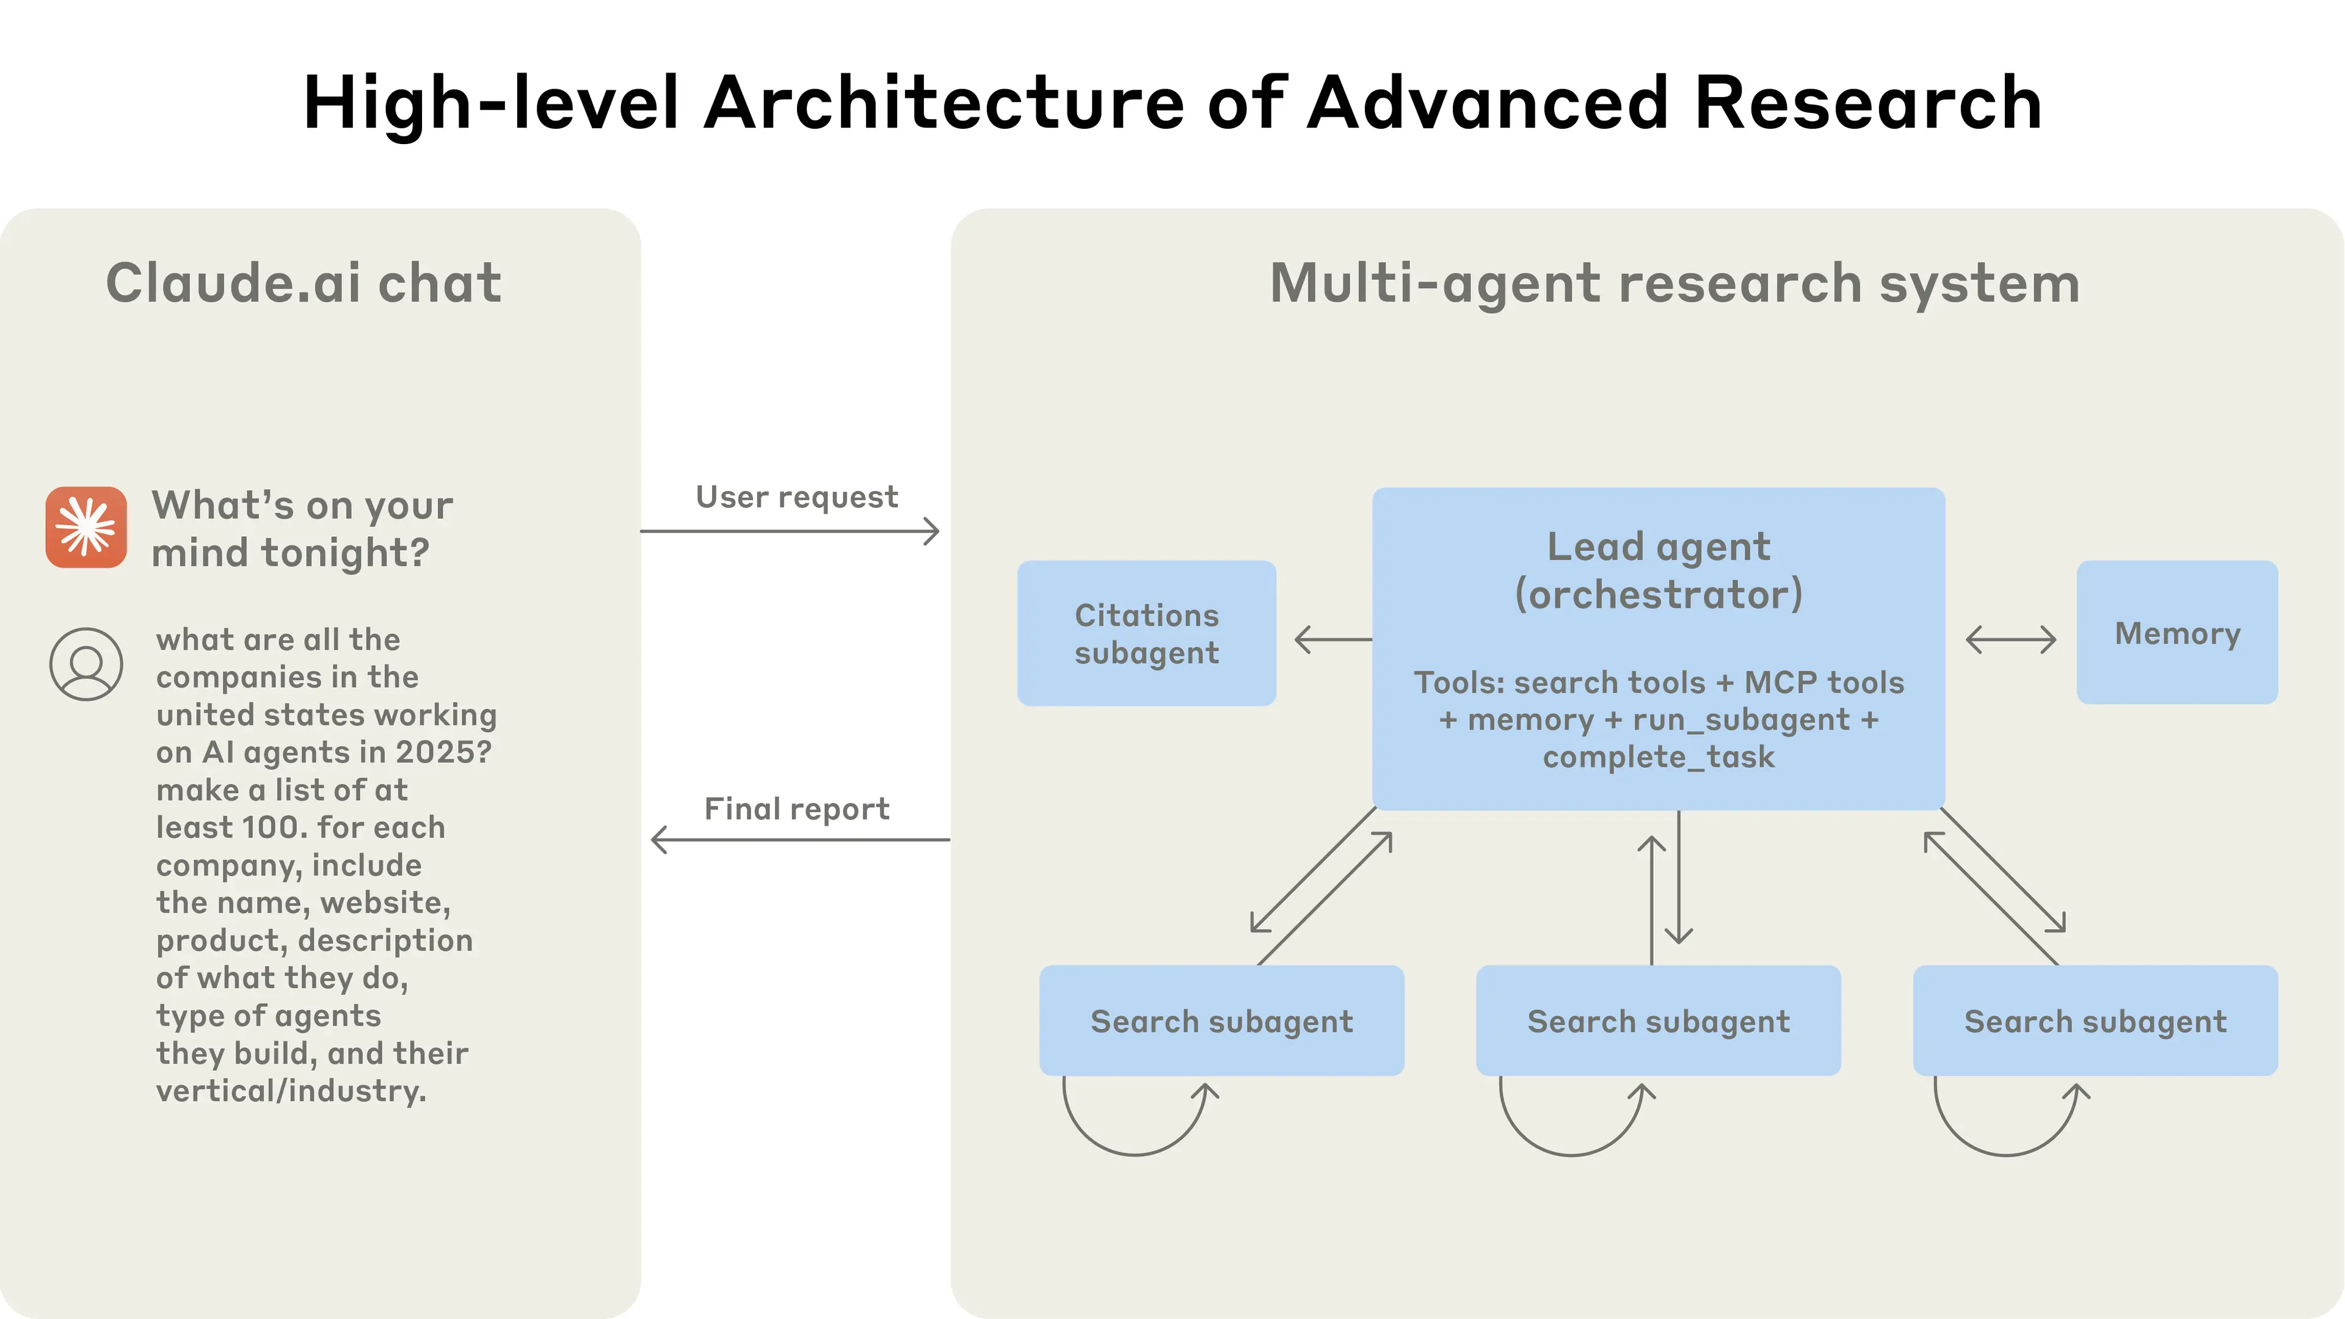

Slide 5
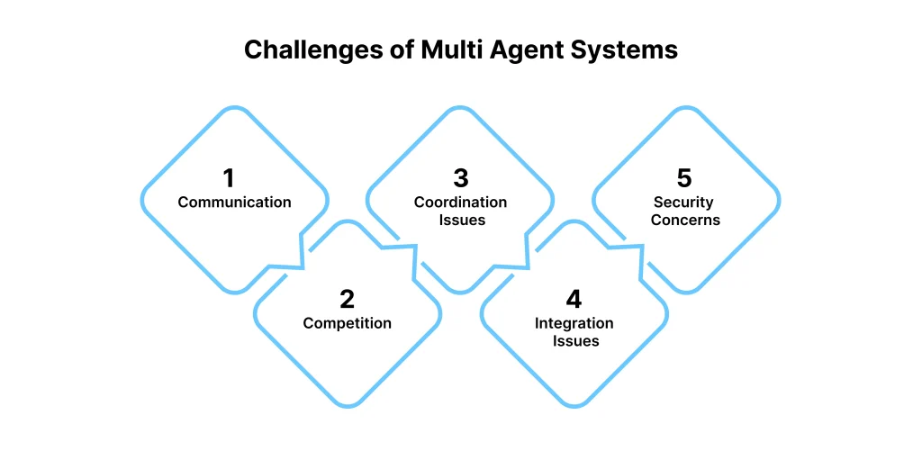
Challenges with a multi AI-agent system

Slide 6
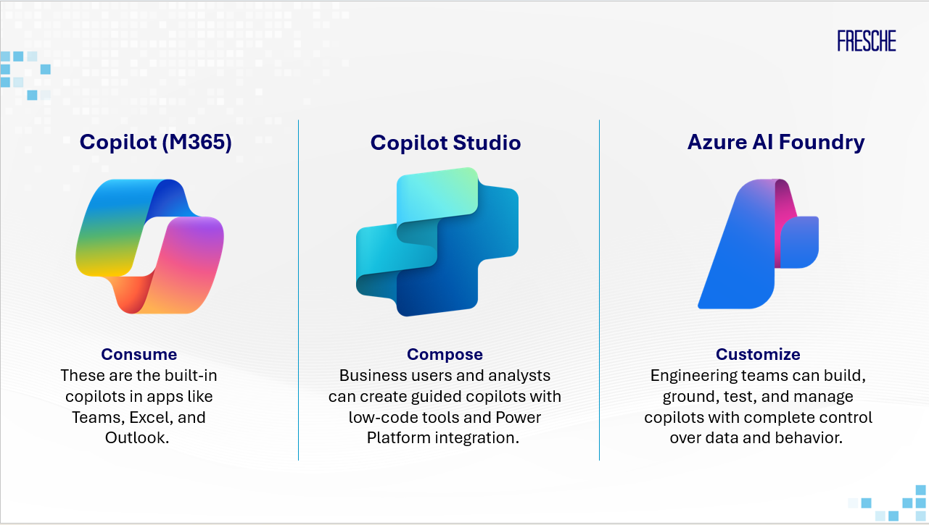

Microsoft AI Agent Ecosystem

Slide 7
How does an Enterprise Deployment differ from prototype?
Modularity
Repeatable
Traceable
Content
safety
Auditable
Network and identity

Slide 8
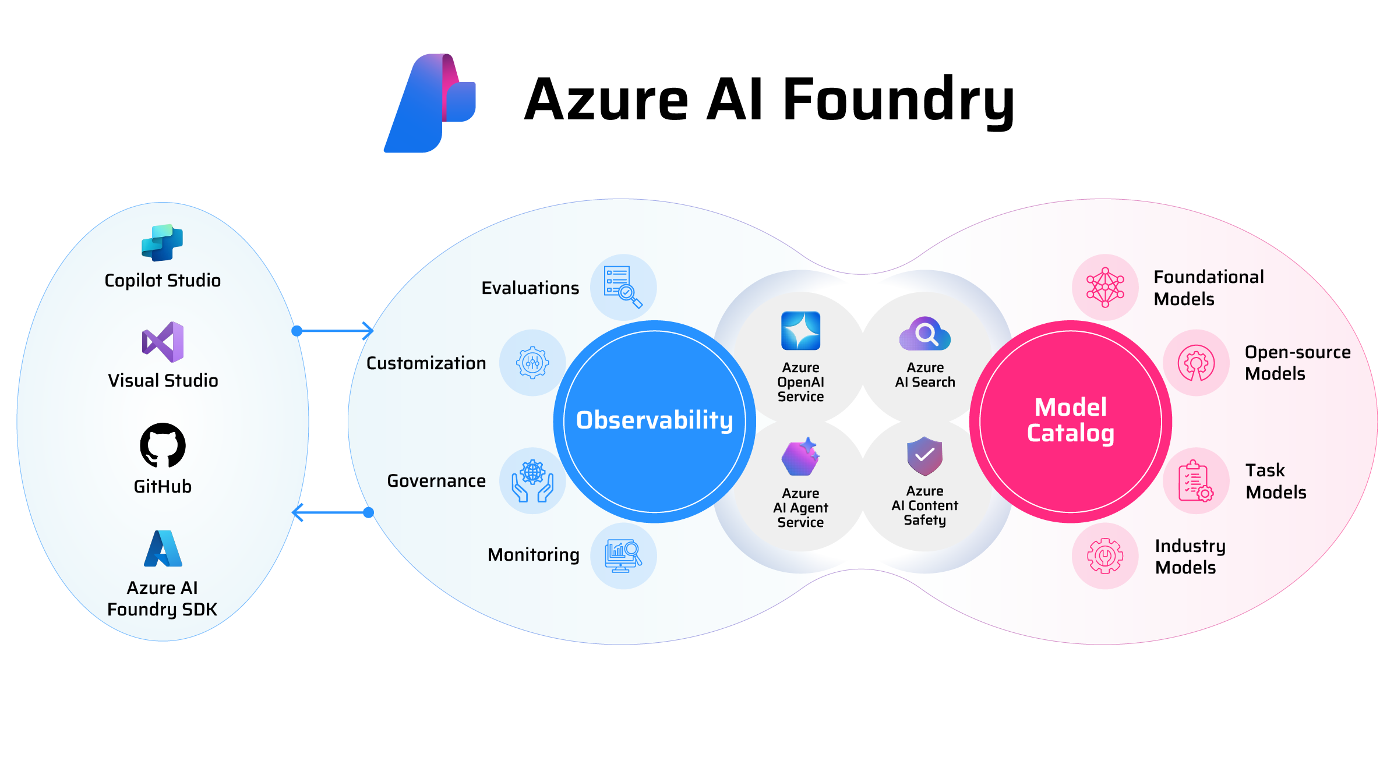

Slide 9
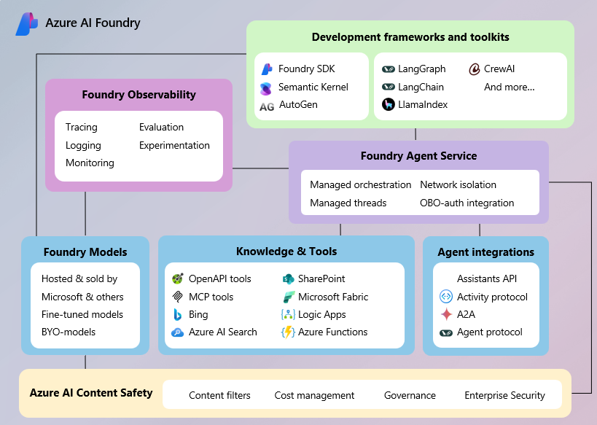

Slide 10
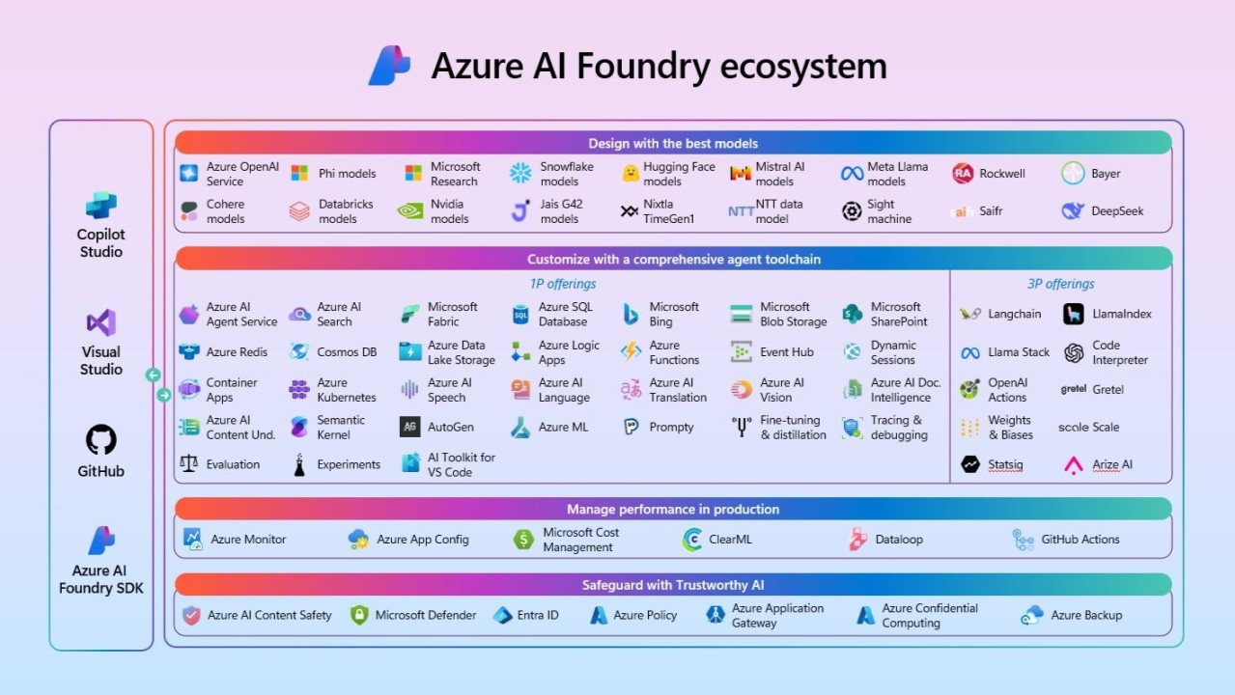

Slide 11
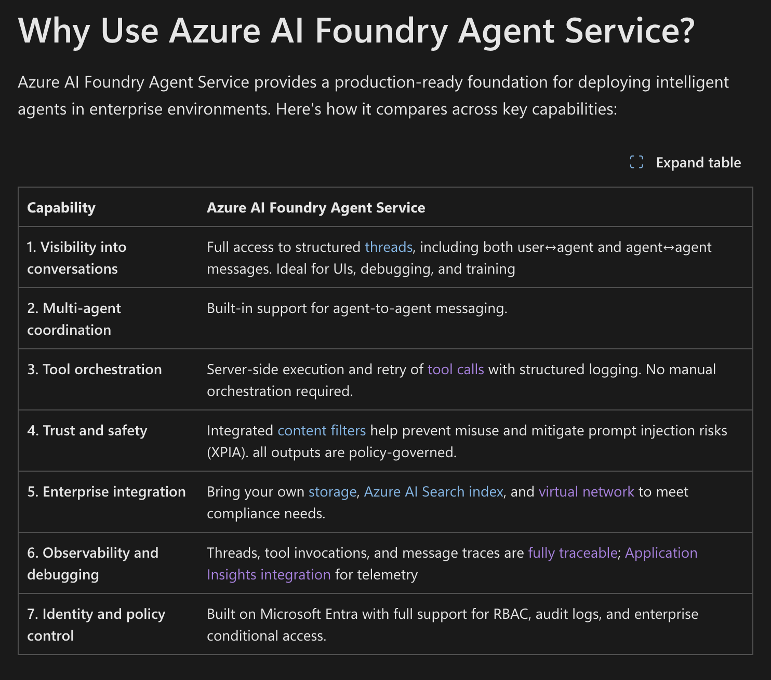

Slide 12
How do I select the best model for my use case?
To select the best language model for you use case, you need to decide on what criteria you're using to filter the models. The criteria are the necessary characteristics you identify for a model. Four characteristics you can consider are:
Task type: What type of task do you need the model to perform? Does it include the understanding of only text, or also audio, or video, or multiple modalities?
Precision: Is the base model good enough or do you need a fine-tuned model that is trained on a specific skill or dataset?
Openness: Do you want to be able to fine-tune the model yourself?
Deployment: Do you want to deploy the model locally, on a serverless endpoint, or do you want to manage the deployment infrastructure?

Slide 13
Filter models for performance
Benchmark | Description
Accuracy | Compares model-generated text with correct answer according to the dataset. Result is one if generated text matches the answer exactly, and zero otherwise.
Coherence | Measures whether the model output flows smoothly, reads naturally, and resembles human-like language.
Fluency | Assesses how well the generated text adheres to grammatical rules, syntactic structures, and appropriate usage of vocabulary, resulting in linguistically correct and natural-sounding responses.
Groundedness | Measures alignment between the model's generated answers and the input data.
GPT Similarity | Quantifies the semantic similarity between a ground truth sentence (or document) and the prediction sentence generated by an AI model.
Quality index | A comparative aggregate score between 0 and 1, with better-performing models scoring a higher value
Cost | The cost of using the model based on a price-per-token. Cost is a useful metric with which to compare quality, enabling you to determine an appropriate tradeoff for your needs.

Slide 14
Utilize Azure AI Foundry Content Safety
Feature | Functionality
Prompt shields | Scans for the risk of user input attacks on language models
Groundedness detection | Detects if text responses are grounded in a user's source content
Protected material detection | Scans for known copyrighted content
Custom categories | Define custom categories for any new or emerging patterns

Slide 15
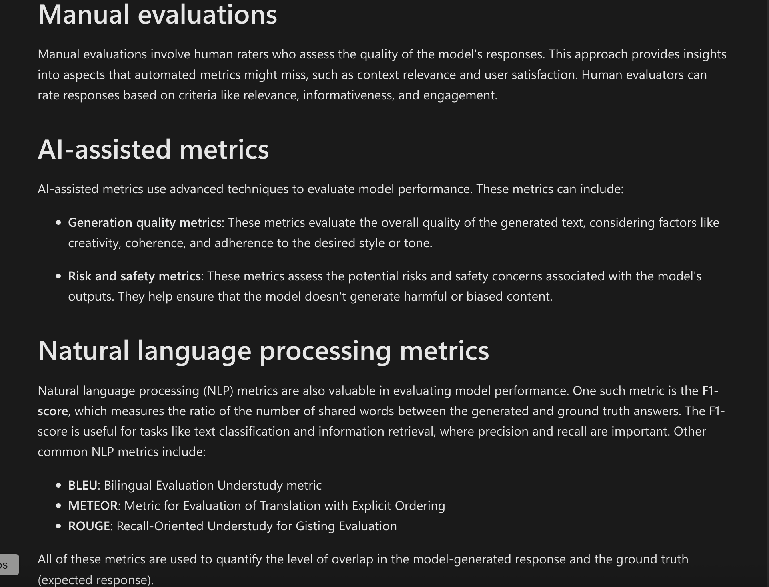
Assess the model performance

Slide 16
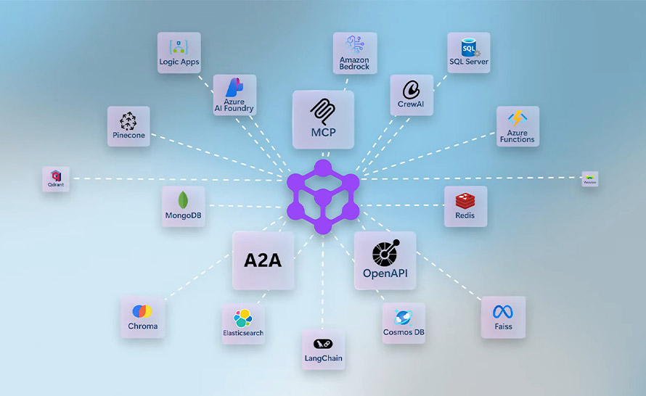

Slide 17
Important aspects for production multi AI-agent setup
Correct
model
Correct orchestration
Correct metrics
Correct
filters
Template workflows
Automation

Slide 18


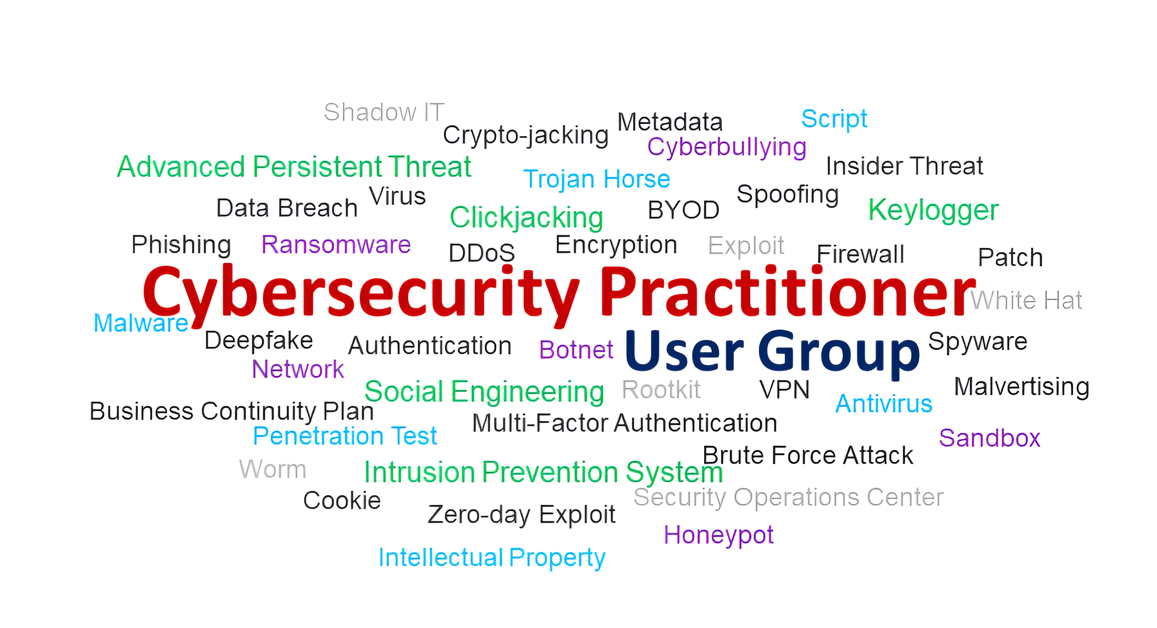
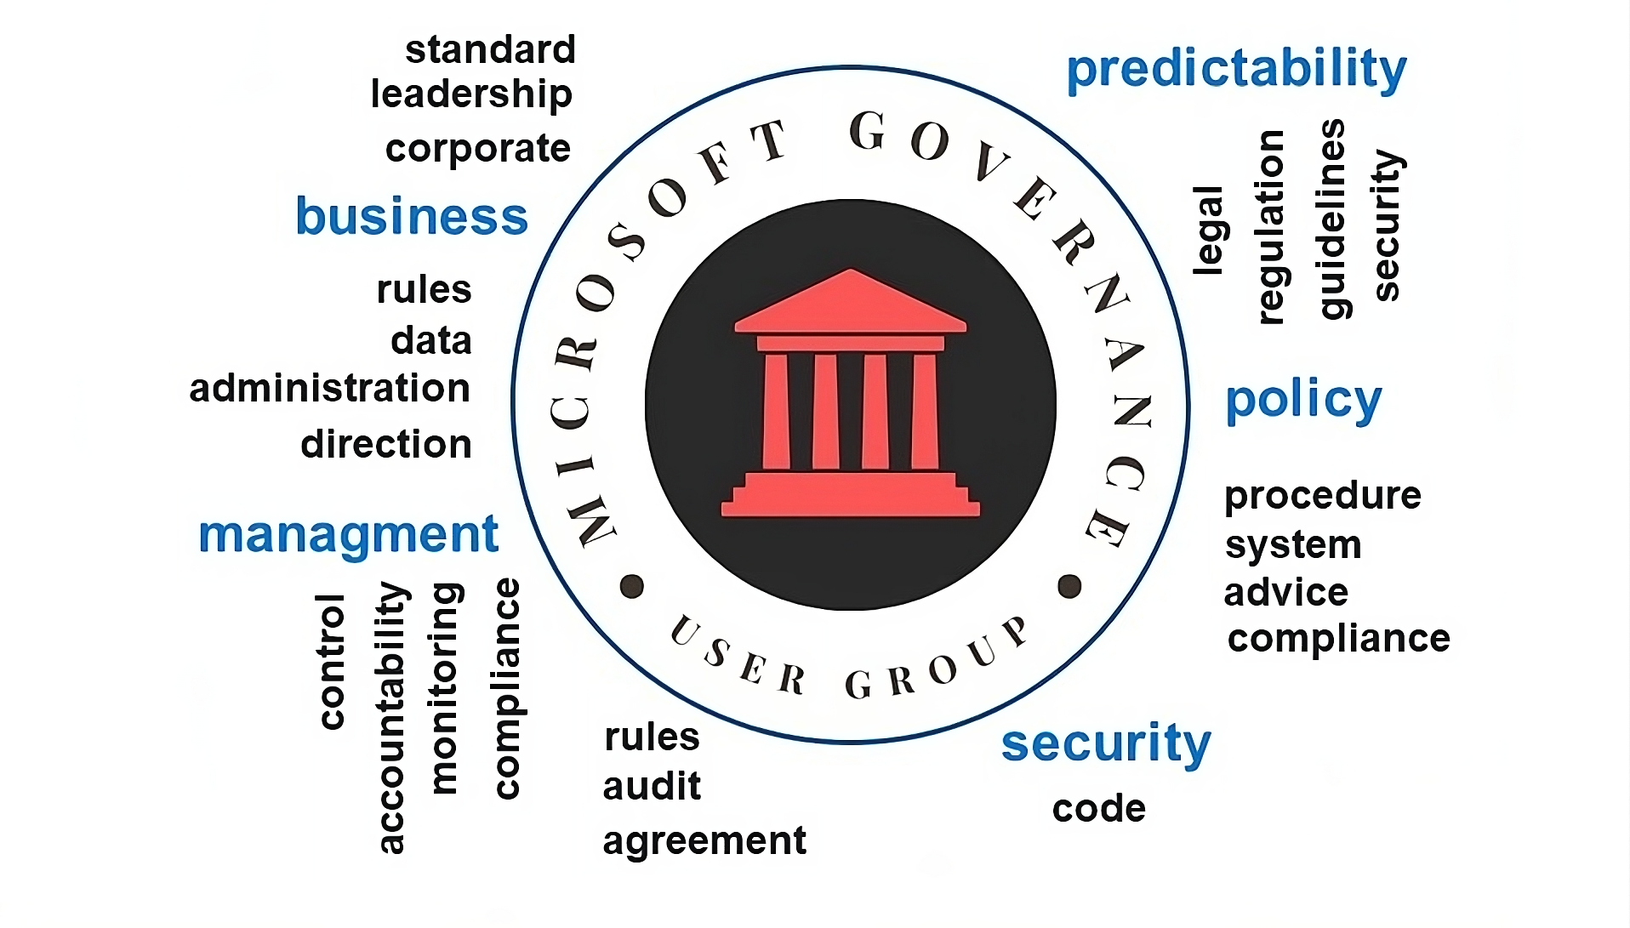
Mohit Sharma
Website: https://mohit13.com/
Masters in Entrepreneurship and Innovation Management
Masters in Information Technology
Master in Robotics and Control

Slide 19
Resources
https://github.com/microsoft/Deploy-Your-AI-Application-In-Production/tree/main
https://devblogs.microsoft.com/foundry/introducing-microsoft-agent-framework-the-open-source-engine-for-agentic-ai-apps/
https://learn.microsoft.com/en-us/azure/ai-foundry/what-is-azure-ai-foundry
Multi-Agent Custom Automation Engine Solution Accelerator: https://github.com/microsoft/Multi-Agent-Custom-Automation-Engine-Solution-Accelerator?tab=readme-ov-file

